Slide 1
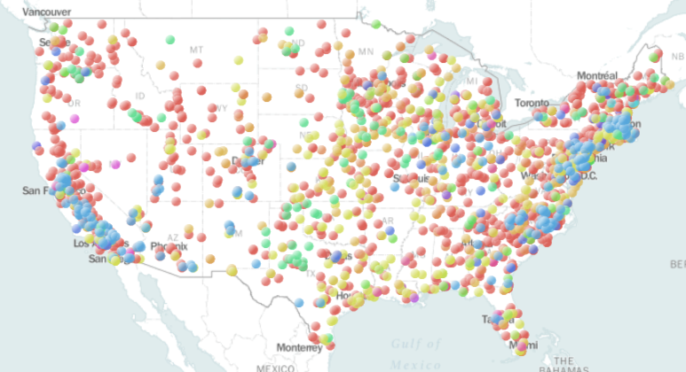
US Power Plant Analysis Pipeline:
Where in the US do I install a plant?

Slide 2
Deciding Factors
Fuel/Cost Availability
Technology/ Efficacy
Market
Demand

Slide 3
Deciding Factors
Fuel/Cost Availability
Technology/ Efficacy
Market
Demand

Slide 4
Data Set
EIA-923
Generation and Costs
EIA-860
Plant Information
County Census Data
2001
.
.
.
.
.
2016
Plant ID
State
Fuel Type/Consumption
Net Generation
Tech Type
Plant ID
Lat/Long (some entries)
Sector
County
County
State
Population

Slide 5
Data Set
EIA-923
Generation and Costs
EIA-860
Plant Information
County Census Data
2001
.
.
.
.
.
2016
Plant ID
State
Fuel Type/Consumption
Net Generation
Tech Type
Plant ID
Lat/Long (some entries)
Sector
County
County
State
Population

Slide 6
Data Set
EIA-923
Generation and Costs
EIA-860
Plant Information
County Census Data
2001
.
.
.
.
.
2016
Plant ID
State
Fuel Type/Consumption
Net Generation
Tech Type
Plant ID
Lat/Long (some entries)
Sector
County
County
State
Population
Data Cleaning/Validation, Find Missing Values, Label Matching
Compiled Data
11,000 plants, 16 years
180,000 samples, 13 Features

Slide 7
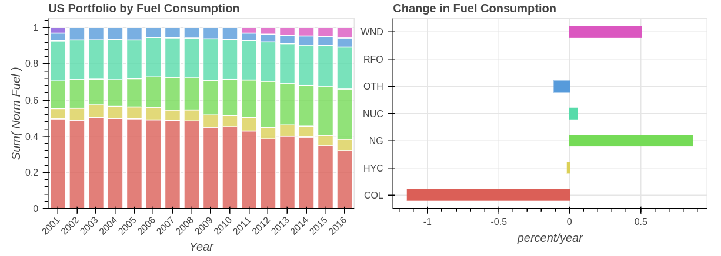
Fuel Trends
Natural Gas and Wind replacing Coal

Slide 8
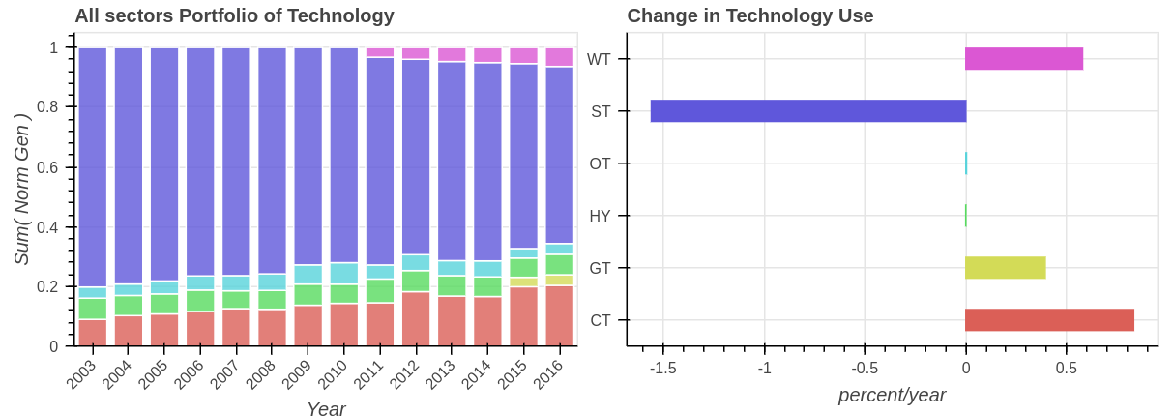
Technology Trends
Combined Cycle and Wind Turbine Replacing Steam Technology

Slide 9
Predictive Analytics
Potential Indicators
Data Set Features
Prediction of
Interest
Geography
Lat/Long, County,
State
Fuel Type Used
18 classes
Population/Power Density
Population,
Neighboring Gen.
Capacity
Continuous
Fuel Used, Sector, Tech Trends
Fuel consumption, Efficiency, Sector
Technology
13 classes

Slide 11
Back Up Slides

Slide 12
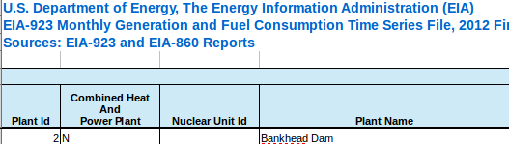
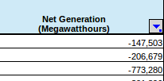
Data Pipeline
EIA-923
Generation and Costs
EIA 860
Plant Information
County Census Data
Predictive Features
Prediction of Interest
Data Cleaning/Preparation
Data validation
Geography
Fuel Type Used
18 classes
Population Density
Capacity
Continuous
Feature Engineering
Gen/Fuel = Efficiency
f(Lat,Long,Gen) = power density
f(Lat,Long,Pop) = Pop density
Feature Matching
Fuel Used, Sector, Tech Trends
Technology
13 classes
'PLNTCODE,N,5,0','PLNTCODE',
'PLANT_CODE','Plant Code'

Slide 13
Proposed Models
Fuel Type
  Unsupervised cluster of Lat/Long to give regions
  Naive Bayes within each cluster to give
Capacity
  GLM with population and power density
Technology
  Random Forest with Fuel Type, Capacity, Sector

Slide 14
Technology
Location
Grid Saturation
Population
Efficiency
Fuel
Features
Eng. Features
Label
11,000 plants
16 years
180,000 samples
Electricity
cost
Capacity

Slide 15
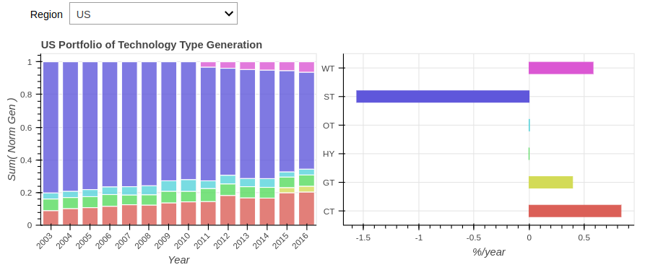
Technology

